Slide 1
Biol 7200: Programming for Bioinformatics Loops, conditionals, and putting it all together

Slide 2
Plan for today
Process substitution
Parameter expansion
Loops
Conditionals
ChatGPT

Slide 3
Plan for today
Process substitution
Parameter expansion
Loops
Conditionals
ChatGPT

Slide 4
Process substitution allows output redirection in addition to pipes
Pipes allow linear output redirects: command 1 -> command 2 -> etc
Process substitution allows output from 1 or more commands to be used without piping
You can only pipe 1 stdout, this allows redirection of multiple stdouts into a single command
2 types of substitution:
Command substitution: as a string $(<commands>)
Process substitution: as a file <(<commands>)

Slide 5
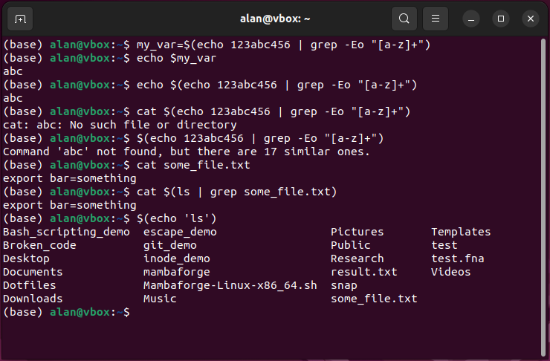
$(<commands>) is used like a variable
Output of commands passed as a string
Can be stored in a variable for later
Can be given as input to commands that take string as input
Cannot be given as input to commands that take a file path as input (unless output is a path to a file)
Can’t be run alone unless output is a command in your path
You might also see backticks, but these are not recommended as they are less visually clear

Slide 6
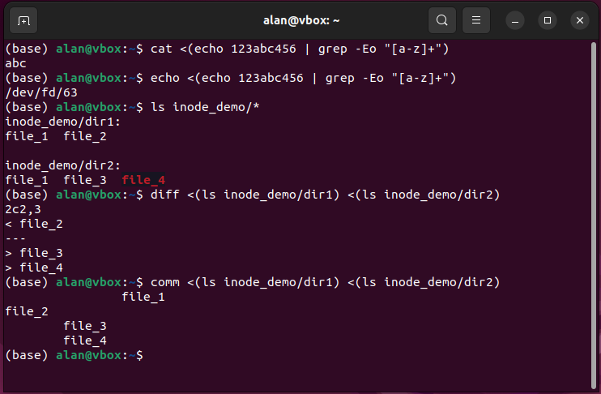
<(<command>) puts the output in a temporary file
Output is passed using a file descriptor (temporary file)
Given an address: /dev/fd/<number>
Can be given as input to anything that takes a file
Can’t be given to anything that takes a string

Slide 7
Plan for today
Process substitution
Parameter expansion
Loops
Conditionals
ChatGPT

Slide 8
Parameter expansion allows you to change variables
Many modifications and other operations supported
https://www.gnu.org/software/bash/manual/html_node/Shell-Parameter-Expansion.html
We’ll cover a few of the most useful here

Slide 9
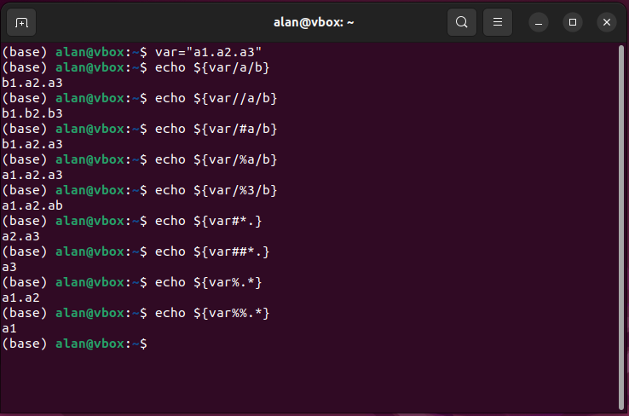
Parameter expansion lets you modify variable values
Uses curly brace syntax ${<variable>}
2 modes:
Replacement ${<var>/[/#%]?<pattern>/<replace>/}
Strip: left-strip ${<var>#{1,2}<pattern>} right-strip ${<var>%{1,2}<pattern>} lazy = (#|%) greedy = (##|%%)
Note: on your keyboard, $ used for variables. Left strip is key to the left. Right strip is key to the right.

Slide 10
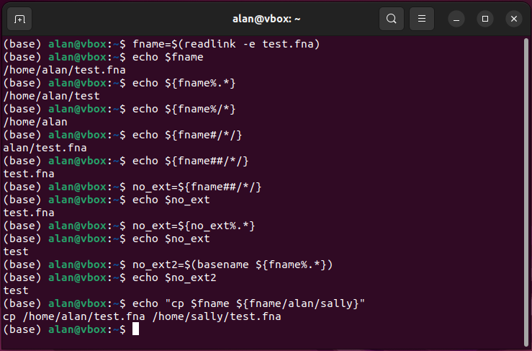
Parameter expansion can be used to modify paths
Many of you used parameter expansion to add accessions to FASTA headers in HW2.
Greedy and lazy pattern matching allows control over path elements modified

Slide 11
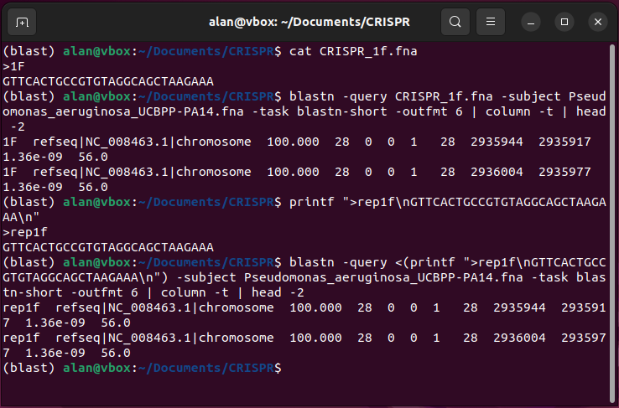
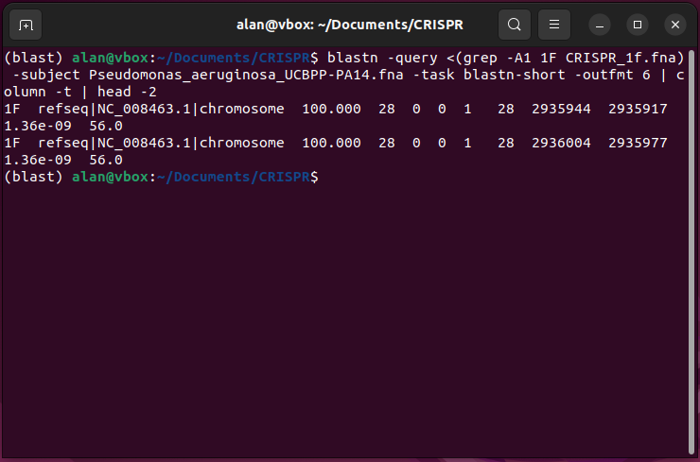
Bonus BLAST examples

Slide 12
Plan for today
Process substitution
Parameter expansion
Loops
Conditionals
ChatGPT

Slide 13
We’ve already been using loops and conditionals
sed
Runs on every line in a file one by one (loop)
Looks for a pattern and, if it finds it, does something (conditional)
Awk
Runs on every line in a file one by one (loop)
Checks conditions and, if they are met, executes a command e.g., awk ‘$3==100’ blast_output.txt if column 3 contains a number equal to 100 in each line of blast_output.txt, awk prints the line
Bash has the same concept (so does Python and every other programming language)

Slide 14
Loops are programming constructs to repeat code execution
2 main types: “for” and “while”
For loops execute code once per element of given array
For banana in bunch_of_nanas; do peel banana; done
While loops execute code until a condition is no longer true
While unpeeled_bananas > 0; do peel banana; unpeeled_bananas-=1; done
Typically use variables that take on new values each iteration.
E.g., $banana will refer to a different banana in the bunch

Slide 15
Loop logic and variable content
Example pseudocode loop (not Bash syntax!): for i in 1, 2, 3 echo $i
In the first iteration of the loop the variable $i has the value 1
In the second iteration, $i has the value 2, etc
Values are assigned at the beginning of each iteration

Slide 16
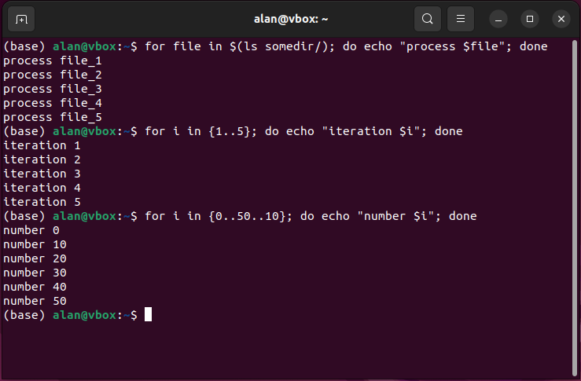
For loops can iterate over arrays and ranges
Arrays or lists of input – do it once per thing in the input
for i in $(ls somedir); do …; done
Ranges – do it N times or use numbers X to Y (optional increment)
for i in {start..stop}; do …; done
for i in {start..stop..inc}; do …; done
you don’t need to use $i within the loop (i.e., can just use for loop to do something not involving $i multiple times)
variable names can be anything (use descriptive names!)

Slide 17
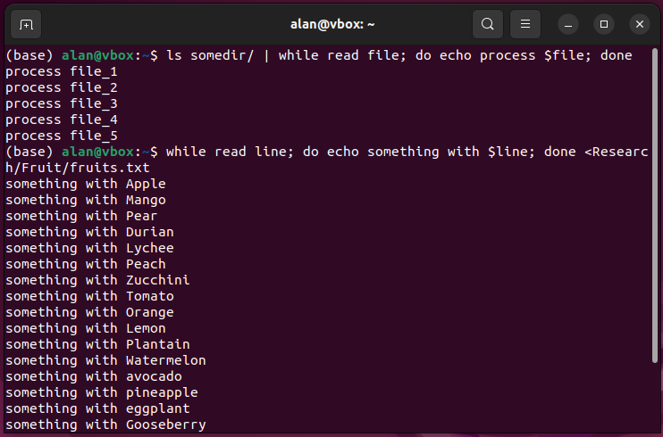
While loops repeat until a condition is no longer true
Can check the outcome of a conditional statement (covered later)
while <condition>; do …; done
Can go forever (or until you stop it)
while true; do …; done
Can iterate over lines of file or stdin
while read line; do …; done < file.txt
cat file.txt | while read line; do …; done

Slide 18
You can use clearer syntax in scripts
Whenever you see a “;” in the one-liner, you can introduce a newline
Convention is to put do on a separate line from code
for i in <array or range>
do
<code>
done

Slide 19
Variables created/modified within loops are changed each iteration
Code within a loop is executed in order.
Variables modified within a loop keep their value from last iteration until they are changed again in the next iteration
What do you think will be printed by the below loop?
j=5 for i in {1..3} do echo $i $j j=$i done

Slide 20
Plan for today
Process substitution
Parameter expansion
Loops
Conditionals
ChatGPT

Slide 21
Conditional constructs check true/false
Different types evaluate different statements
We’ll cover 2 main kinds:
True/false statements like x > y
Command exit codes – did the command succeed or return an error?
Helpful “cheatsheet” with different kinds https://devhints.io/bash#conditionals

Slide 22
Conditional syntax
Conditionals use a special command, [[, which evaluates the code before its closing symbols, ]].
As [[ is a command, don’t forget the whitespace after it!
Syntax is [[ [comparator] <check> <thing> ]]
The comparator is not needed in all cases
e.g. to check if a file exists [[ -f <filepath> ]]
Can combine multiple conditions with && (and) or || (or)
[[ <condition 1> && <condition 2> ]]

Slide 23
Conditionals are typically used by if or while
if is used to execute code based on conditions.
while loops over a block of code until the condition is no longer true

Slide 24
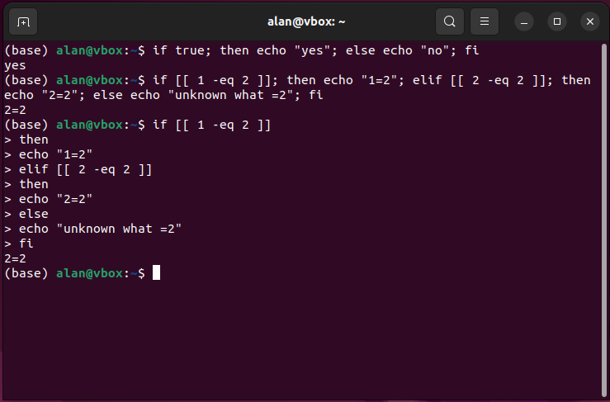
If can be used to execute different code
Supports multiple conditional code blocks with if, elif, else
Single line syntax if <condition>; then <code 1>; elif <other condition>; then <code 2>; else <code 3>; fi
Note starts with if, ends with backwards if (fi)
Script syntax if <condition> then <code 1> elif <other condition> then <code 2> else <code 3> fi

Slide 25
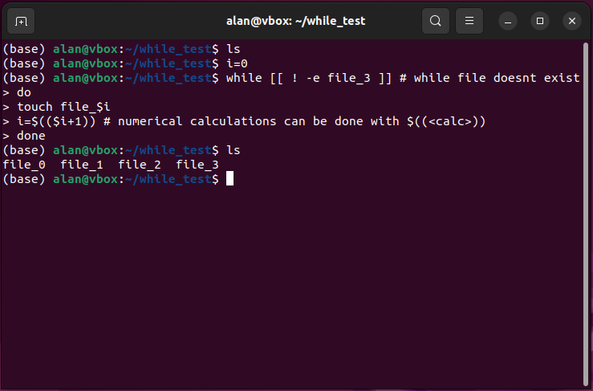
While can execute code until a condition is met
Checks the condition at the start of every iteration
Be careful to define a condition that will be met – it runs quickly!
Once the condition is met, loop ends

Slide 26
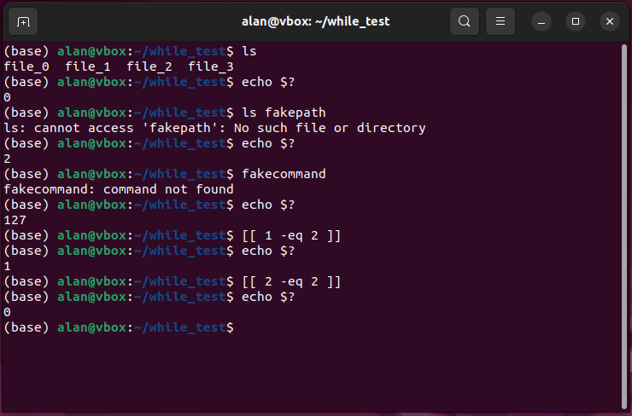
How are conditionals checked? Exit codes
if and while are checking the exit code returned to them
View the exit code of the last command with $?
Commands return exit codes to indicate if they executed successfully or had an error
zero means success, non-zero means error
Which number was returned can often be used to indicate what the error was
[[ is a command that returns exit codes indicating if the condition was true (0) or false (1)

Slide 27
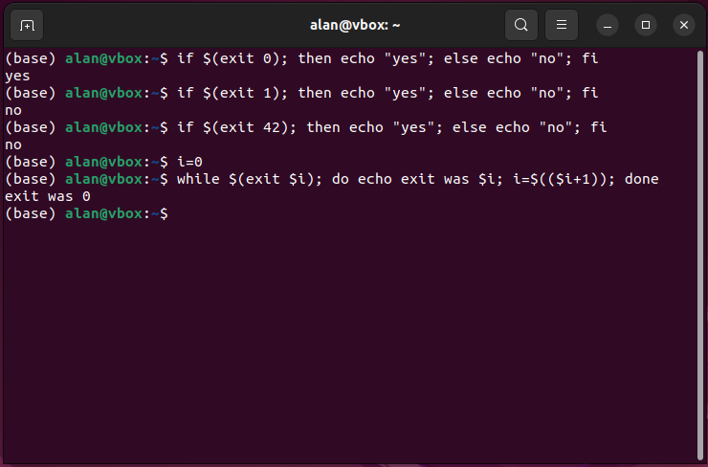
Exit codes are sent using the exit command
Can be used in scripts to end execution prematurely with non-zero exit
Can also explicitly exit with zero if you like (otherwise exit code from last command is used)
Exit code zero == true
All other numbers == false

Slide 28
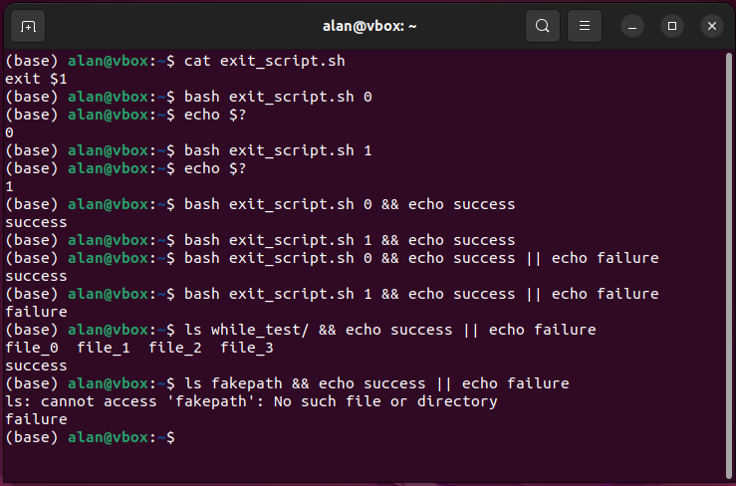
Conditional execution runs code based on command error code
Consider the following desire:
Run X
If X succeeds: do Y
Else: do Z
Conditional execution achieved using && (zero exit) and || (non-zero exit)
Very useful to handle when commands fail in your pipelines and wrapper scripts

Slide 29
Plan for today
Process substitution
Parameter expansion
Loops
Conditionals
ChatGPT

Slide 30
Chatgpt can write (often bad) code
Currently, it writes bad code that (sometimes) runs and does what you want
Using it to help you get started is fine
Using it without understanding what the code does is not fine
It’s a tool that can help you learn (although not ideal to learn from bad code)

Slide 31
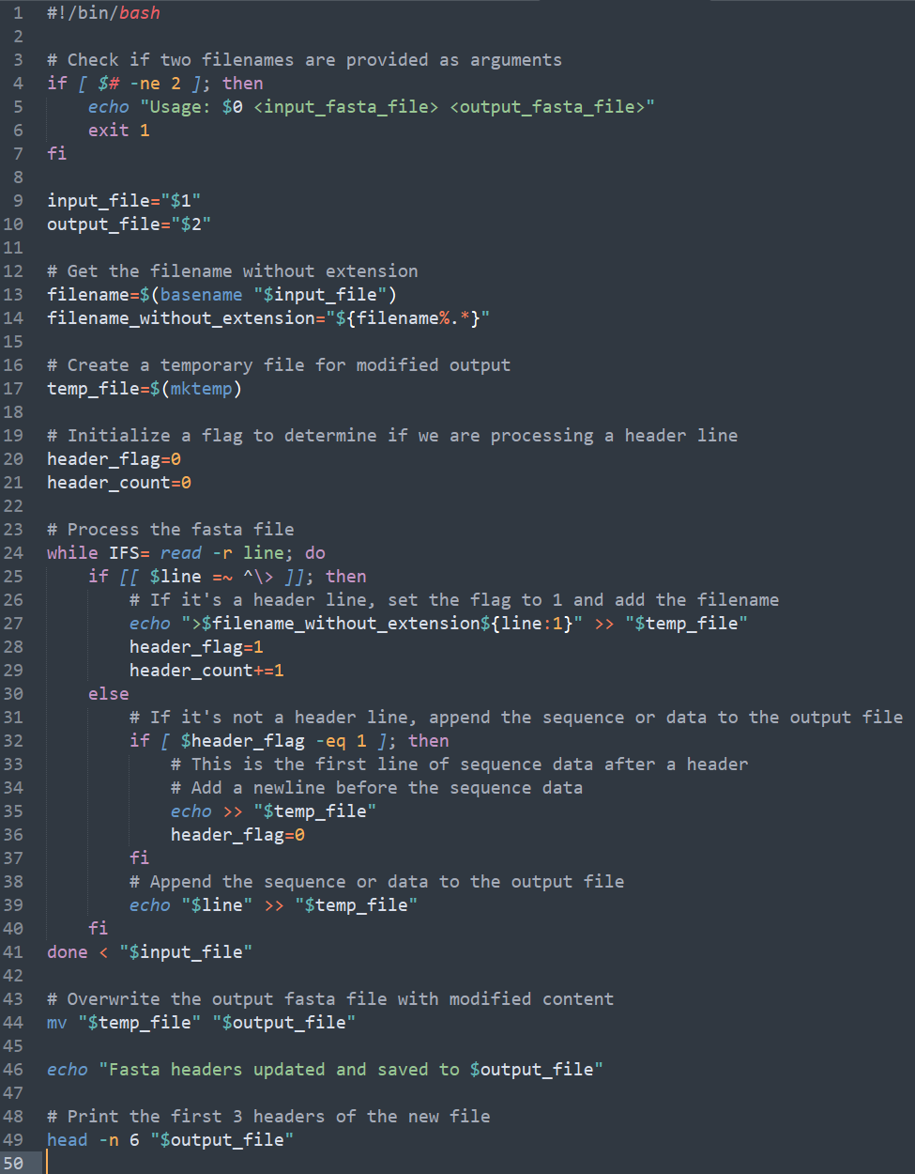
Chatgpt code example
“Write a bash script that adds the accession number (i.e., the filename without the extension) to the beginning of each header line in the file and outputs the modified FASTA sequence to a new file. print the first 3 headers of the new file”

Slide 32
Chatgpt code problems - setup
Input validation is nice, but excessive for homework assignment
Filename extension removal fine, but could be done in 1 line
Making a temp file is strange when the output will overwrite a new file
Why is it tracking when a header line is reached?
Why is it counting headers lines?

Slide 33
Chatgpt code problems - body
Loop setup is strange: Why is it setting $IFS? Why use –r for read?
echo with string concatenation is a strange approach. Slower and more complicated than sed
$header_flag only exists for unnecessary addition of blank line after header – doesn’t understand format rules
Mixing [[]] and [] in conditionals means not adhering to a set style (e.g., https://google.github.io/styleguide/shellguide.html#s6.3-tests)

Slide 34
Chatgpt code problems - finish
$temp_file didn’t need to exist
$header_count never used
Why echo that you have finished? Clutters stdout with extra data
head -6 to show the first 3 headers shows it doesn’t understand FASTA format

Slide 35
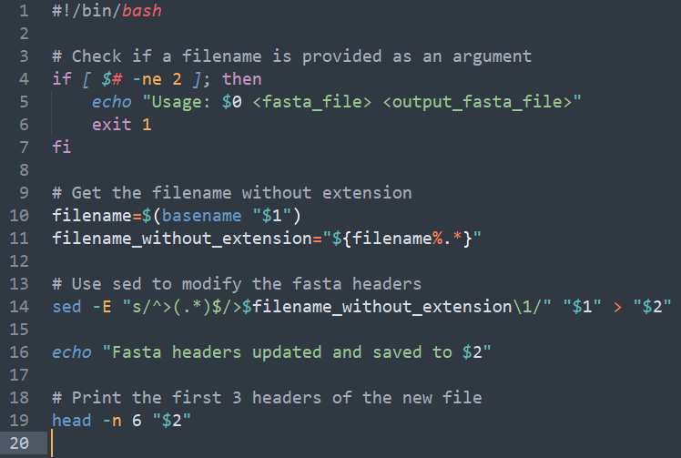
Do it again, but better
“Rewrite the script using sed instead of echo”

Slide 36
Still issues present
Script much simpler when using a more appropriate tool
Why using regex match groups?
“^” and “$” unnecessary in regex
“>” always at beginning so don’t need “^”
“.*” greedy so always matches until end of line so don’t need “$”
It doesn’t seem to understand what the code is doing – i.e., replace “>” with “>$var”
sed ‘s/(.*)/\1/’ is equivalent to not matching the stuff in the first place. Red flag for someone reading the code

Slide 37
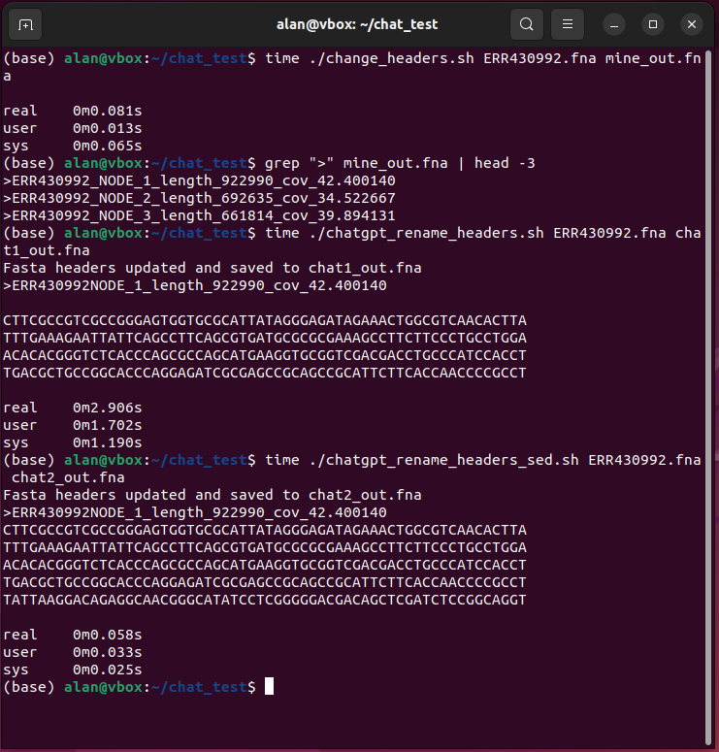
Results
A loop with echo and string concatenation is ~35 times slower
It only wrote a faster script because I told it the right approach.
Many of you decided to add a separator character between accession number and original header. ChatGPT didn’t.

Slide 38
End of Lesson

